Slide 1
2020 Publisher’s Report
Schweizerische Botanische Gesellschaft
www.springer.com/35

Slide 2
About this journal
International Scientific Journal, Peer reviewed
Alpine Botany is providing a forum for plant science studies at high elevation with links to fungal and microbial ecology, including vegetation and flora of mountain regions worldwide.
Covers biogeography, biosystematics, evolutionary biology, population biology, ecophysiology and functional ecology of plants and vegetation, and interactions of plants with plants, animals or microorganisms.
Alpine Botany is the official publication of the Swiss Botanical Society and is published by Springer International Publishing AG, Basel, Switzerland. The first issue was published in 1891.
Previously Botanica Helvetica, relaunched in 2011 as Alpine Botany)
Open Access in Alpine Botany with Open Choice (transformative journal)

Slide 3
International Editorial Board (since 2011)
Editor-in-Chief Jürg Stöcklin, Switzerland
Senior Editor Christian Parisod, Switzerland
Editorial Board
Jake Alexander, Switzerland
Mary T. Kalin Arroyo Chile
Fabien Anthelme, France
Christian Brochmann , Norway
Philippe Choler, France
Lohengrin Cavieres, Chile
Katharine Dickinson, New Zealand
Markus Fischer, Switzerland
Joachim W. Kaderei, Germany
Christian Körner, Switzerland
Gaku Kudo, Japan
Sébastien Lavergne, France
Andreas Lüscher, Switzerland
Vladimir Onipchenko, Russia
Harald Pauli, Austria
Christian Rixen, Switzerland
Niek Scheepens, Germany
Christoph Scheidegger, Switzerland
Gerald M. Schneeweiss, Austria
Peter Schoenswetter, Austria
Eva Spehn, Switzerland
Hang Sun, China
Ørjan Totland, Norway
Andreas Tribsch, Austria
Jurriaan Michiel de Vos, Switzerland
Sonja Wipf, Switzerland

Slide 4
Journal Metrics
History and Costs for the Swiss Botanical Society (SBS)
Since 2005: Published by Springer, Page fee: ca. 36’000 CHF per Year for SBS
2011: Relaunch as Alpine Botany, EditorialManagerSystem, ca. same costs for SBS
2019 onwards: Society members do not receive printed copies, free access to electronic edition. 25 institutional members receive printed copies at a rate of Euro 120. No further costs for Swiss Botanical Society.

Slide 5
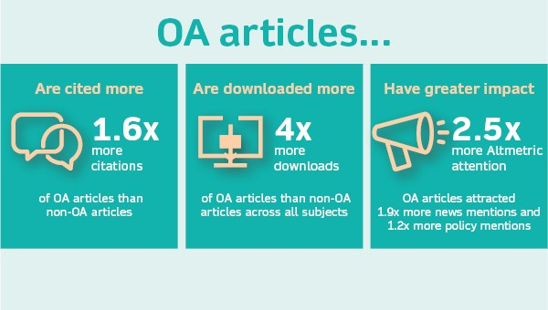
Publishing open access in Alpine Botany
Alpine Botany is a Transformative Journal (TJ). When research is accepted for publication, authors can choose to publish using either the traditional publishing route OR via immediate gold Open Access (publication fee).
2021: open access (gold standart): ca. 50%
Alpine Botany is actively committed to becoming a fully Open Access journal. We will increase the number of articles we publish OA, with the eventual goal of becoming a fully Open Access journal.

Slide 6
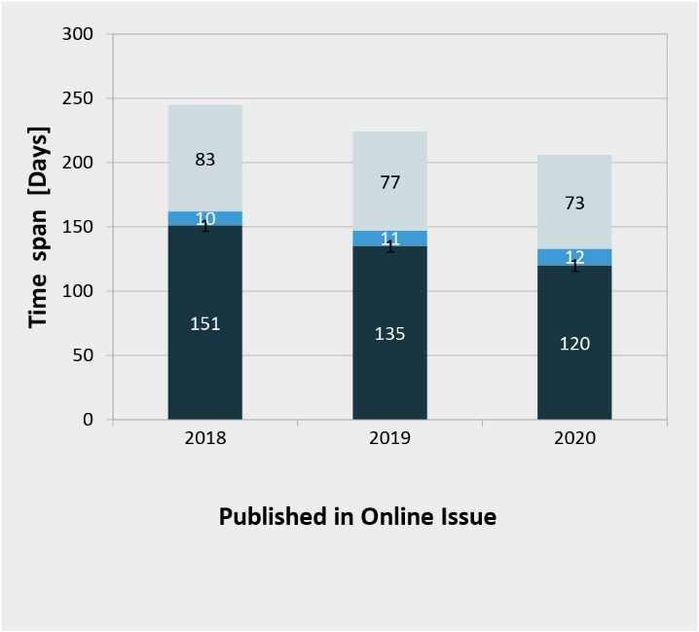
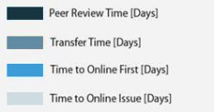
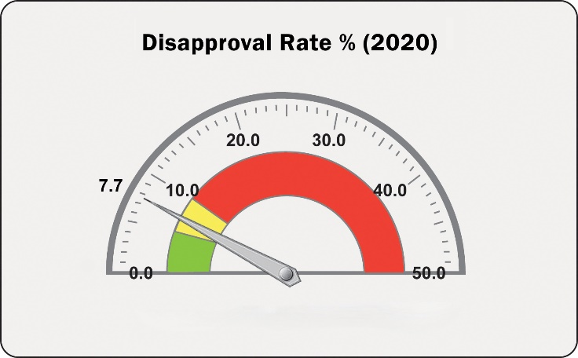
2 Production
2.2 Production Turnaround Time
Average Time from Acceptance at Publisher to Publication in an Online Issue (by year 2018 + 2019 + 2020)
Disclaimer: For the time to production (‘Received by Springer Nature) the ‘Final Disposition Date’ is taken. There could be a time lag between the ‘Final Decision Date’ and the ‘Final Disposition Date’.

Slide 7
3 Circulation
Online Deals
 | 2018 |  | 2019 |  | 2020
Region | Number of Deals | Institutions with exposure via online deals | Number of Deals | Institutions with exposure via online deals | Number of Deals | Institutions with exposure via online deals
Americas | 148 | 2,181 | 125 | 1,269 | 137 | 1,800
Asia Pacific | 182 | 2,366 | 436 | 2,114 | 489 | 2,022
EMEA* | 150 | 4,553 | 135 | 3,135 | 212 | 4,306
Grand Total ** | 480 | 9,100 | 696 | 6,518 | 838 | 8,128
The type of deal, as well as the type and number of “members” or “sites” participating in these deals, varies greatly. Also the way in which these members and sites are administrated in our contracts can vary considerably. For example in a consortium deal we count institutions as “members”, which in themselves may represent many locations/schools/libraries. Therefore the numbers given in the tables in this section should be viewed as an indication of distribution of the title through online deals. The figures provided under “Institutions with exposure via online deals” refer to institutions that have exposure to the journal as part of an online deal with Springer (consortia, multi-site licenses, and site licenses). This does not mean that these institutions had fully paid institutional subscriptions and/or are paying the equivalent of the list price to obtain access to the journal under an online deal arrangement.
*EMEA = Europe, Middle East and Africa
**The Research4Life online access data are not included in the above table (see Appendix for more information)
Run Date: 08th April 2021
3.3 TA Agreements/Compact Deals
Transformative Agreements: https://www.springernature.com/gp/open-research/institutional-agreements
Our Transformative Agreements enable participating institutions to combine journal subscription access along with OA publication costs (APCs).
In addition to managing the cost and administration of OA, Transformative Agreements offer authors an easy way to comply with funders’ OA requirements.
If your institution has a Transformative Agreement, you may publish your article OA with your fees covered, in Springer Nature journals that are included in the agreement.
 | 2020
Region | Number of Deals | Institutions with exposure via TA Agreements
Americas
Asia Pacific | 2 | 57
EMEA* | 11 | 1,891
Grand Total ** | 13 | 1,948

Slide 8
4 Usage
4.1 Successful Full-Text Article Requests
Full-Text Article Requests 2017 – 2021 (YTD)
Totals
2017 | 19,904
2018 | 20,016
2019 | 19,998
2020 | 25,790
2021 (YTD) | 4,729
Source: COUNTER usage data on Google BigQuery. Downloads from SpringerLink, Nature.com and BMC Platform .

Slide 9
4 Usage
4.4 Visits by Geography
Visits by Geography
Top 5 Europe
Switzerland | 8%
Germany | 5%
United Kingdom | 4%
Norway | 3%
Italy | 3%
Source: Google Analytics data on Google Big Query.

Slide 10
5 Impact
5.1 Coverage in Abstracting & Indexing (A&I) Services
Alpine Botany is currently covered by the following (A&I) services:
AGRICOLA; BIOSIS; Biological Abstracts; CAB Abstracts; CNKI; Current Contents/ Agriculture, Biology & Environmental Sciences; Dimensions; EBSCO Discovery Service; EMBiology; Elsevier Biobase; Geobase; Google Scholar; Institute of Scientific and Technical Information of China; Japanese Science and Technology Agency (JST); Journal Citation Reports/Science Edition; Meta; Naver; OCLC WorldCat Discovery Service; ProQuest Agricultural & Environmental Science Database; ProQuest Biological Science Database; ProQuest Central; ProQuest Natural Science Collection; ProQuest SciTech Premium Collection; ProQuest-ExLibris Primo; ProQuest-ExLibris Summon; SCImago; SCOPUS; Science Citation Index Expanded (SciSearch); TD Net Discovery Service; UGC-CARE List (India)

Slide 11
5 Impact
5.4.1 The JCR Impact Factor trend: Number of Citations and Number of Source Items
This graph shows in one view how the number of source items (“articles”) and the number of citations are affecting the Impact Factor. The following slides will provide details about the sources of citations and their distribution over the journal’s articles, including non-cited articles as well as by article type.

