Slide 1

Événements virtuels: expériences SVSN
Julien Leuthold
svsn@unil.ch
www.svsn.ch

Slide 2
Technical aspects
The committee decided to use Zoom, after a market study.
Using a UNIL account, we can host up to 300 participants for an unlimited period.
The host and control can be shared, microphones can be muted, the conference is easy to record and a .mp4 video is automatically created (with agreement from the speaker).
Sound and video quality are excellent (all cameras switched off). Participants may unmute their microphone during the meeting and create interferences.
We have decided to let participants enter freely the meeting.

Slide 3
Participants
Globally x2-x3 the number of participants during the meeting (55-150 connected, more?). More persons reached later, via YouTube.
People are used to videoconferences. No age bias. Less local and more regional.
Mix of members & non-members, as ‘normal’ (nb. popular topics bring more non-member people).
Good participation of the public, using the chat and/or during the questions at the end. Might be useful having someone checking the chat (and answering ‘urgent’ questions during the presentation).
Informal discussion sometimes goes on after the last question.

Slide 4
Communication, advertisement
Similar tools:
  Printed/e-mailed monthly program,
  e-mail reminders to all members (+20-30% registrations every time),
  Website,
  Facebook,
  Our program is sent to media (forwarding the info?),
  No communication on the Plateforme NWR?
  Encourage exchanges with the other Societies (from the same region)?
We require a pre-registration, but the link to the meeting is provided on our website on the D-Day (and it is always the same).

Slide 5

Meeting
We have prepared our own background, to provide our contact details during introduction and moderation of questions.

Slide 6
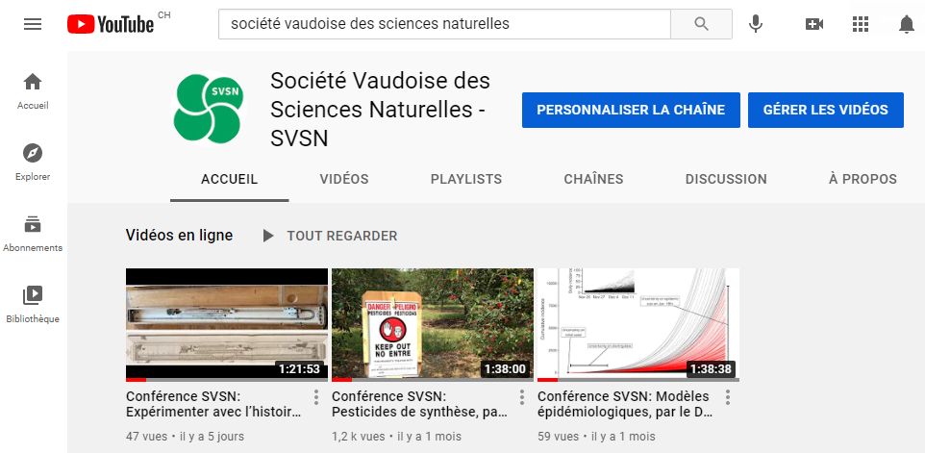
YouTube
27 abonnés
Need a free Gmail account
Publication of the raw video takes only ca. 1h.

Slide 7
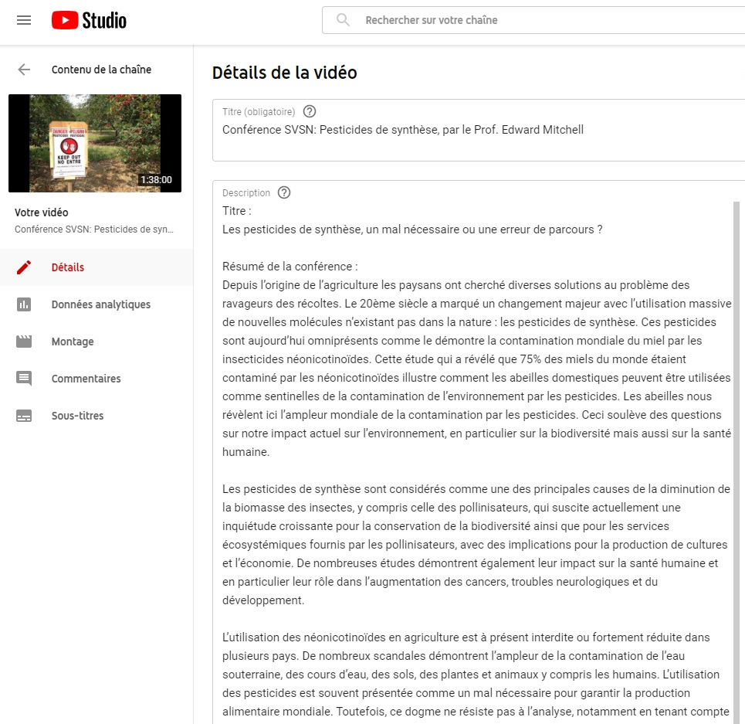
YouTube
General info about the content of the video, to attract ‘customers’.

Slide 8
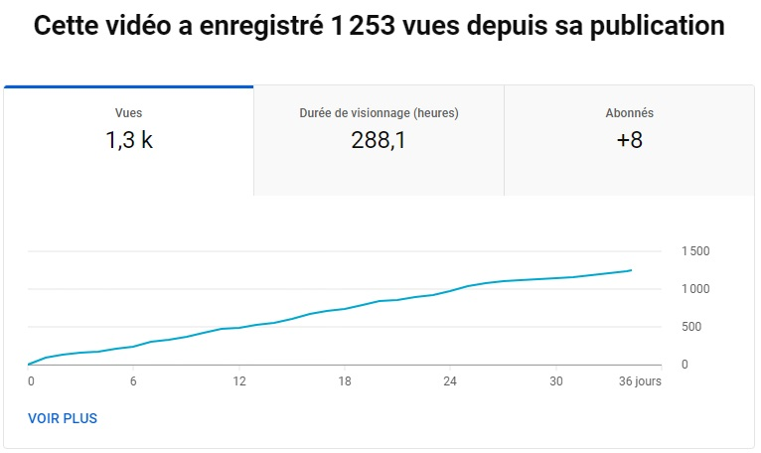
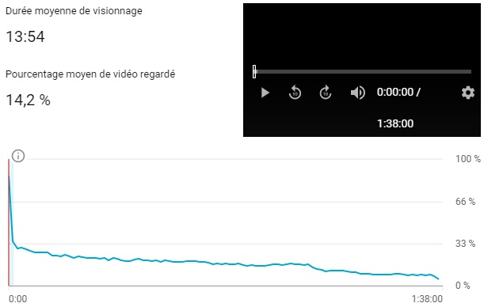
YouTube
Long-term accessibility.
Apparent wide impact on the community.
70% views are visitors having left during the intro.
20% watching until the end of the presentation (10% until the end of questions).
end of intro (2’)
end of presentation (65’)

Slide 9
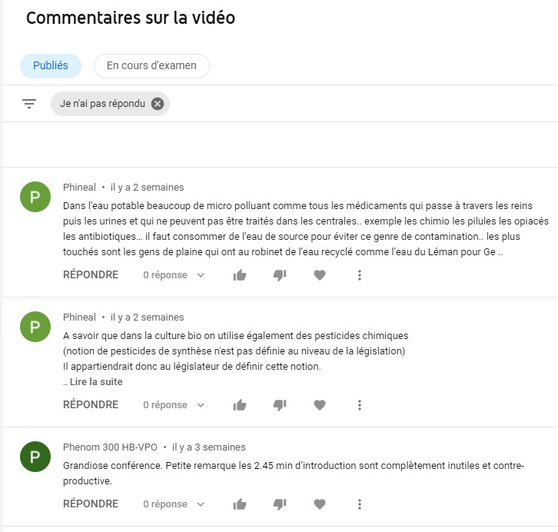
YouTube
Reactions and comments from the users.
Need some regular checks…

Slide 10
Future developments
We will offer hybrid conferences (Covid, avoiding displacement),
  with a record of the slides via Zoom,
  filming the speaker during the questions-answers,
  audio connexion via a room microphone,
  sharing the event live on Facebook?
  foreign speakers?
=> Need equipment + staff + editorial work

Slide 11
Conclusions
☺
☹
Keeping contact with our members,
Local → regional outreach,
Increased visibility for the Society,
Little added work,
but lacking the networking aspects.
but could benefit from further (national) advertisement.
but no new membership?
but very amateur product.
There is an important potential to exploit and benefit from online tools, if we wish to go ahead…

