Slide 2
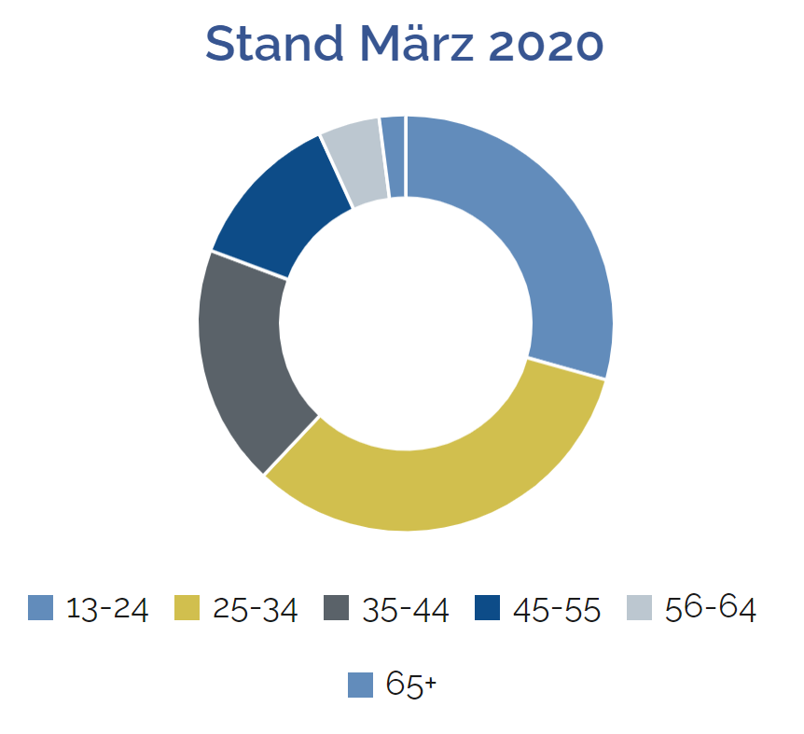
#insta-schweiz
Monthly 2.7 million users in switzerland
Worldwide monthly 1 billion active users (500 mio. daily)
Main users between 13-24 and 25-34 years
Female and male users are equally present
Created: 2010, facebook took over company in 2012
2018 IGTV, to upload longer movies
Optimal Post-frequency: 1x per day or 3-4x per week
Plan feeds in advance (Planoly, Unum, Preview)
Costs: none
Altersverteilung der Nutzer

Slide 3
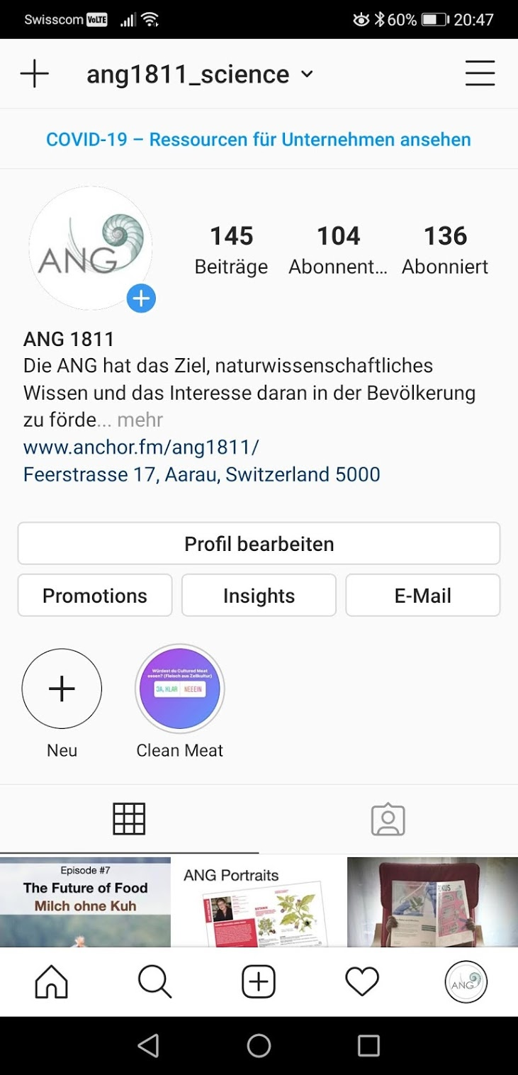
Setup your account and profile
Profile Photo: big and simple
Profile Information: add Website, Infotext
Switch to a business profile (you need a facebook page to switch to business profile)
2. Post photos or videos
+ icon to add photos of library or video
Up to 10 photos/videos in one post
Schedule instagram posts (also possible from your desktop)
Make sure you are posting consistently
Write a caption (appears below your media)
Mention another account (i.e. @username), add hashtags (i.e. #hashtag)
Tag people, add location
Share your post on other social media profiles

Slide 4
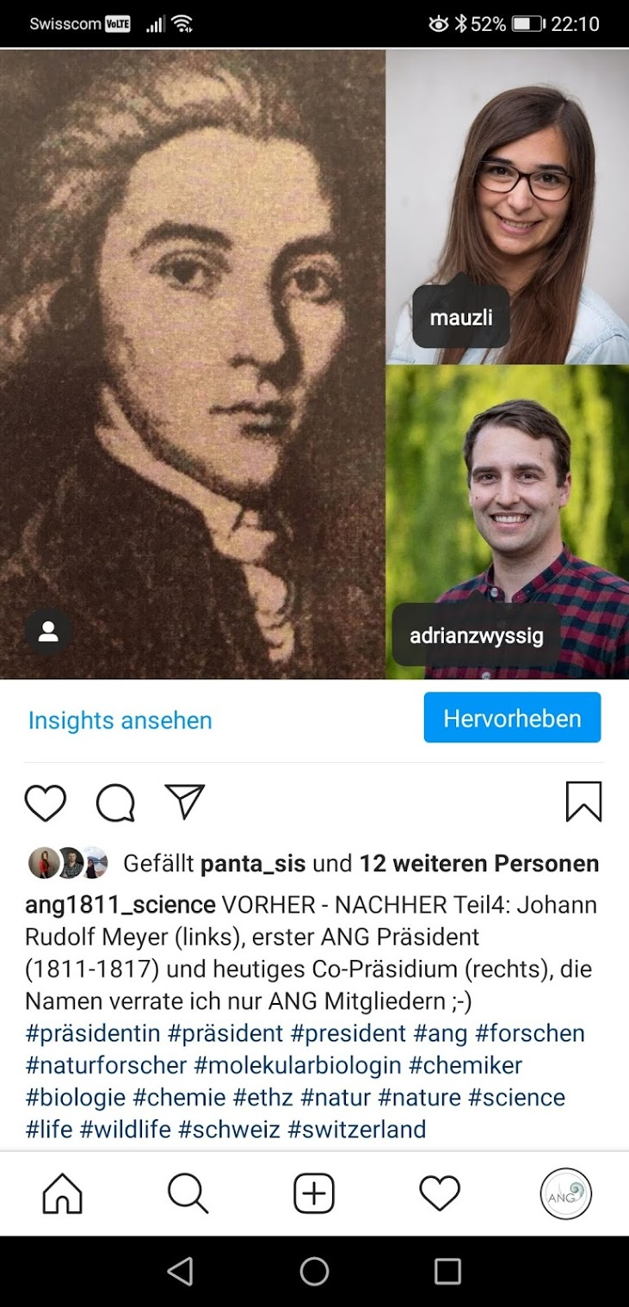
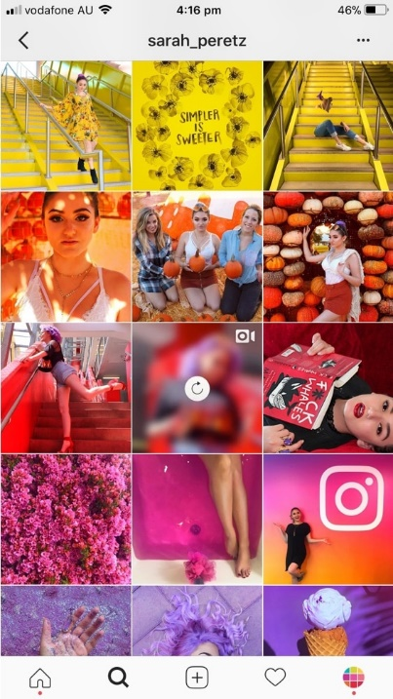
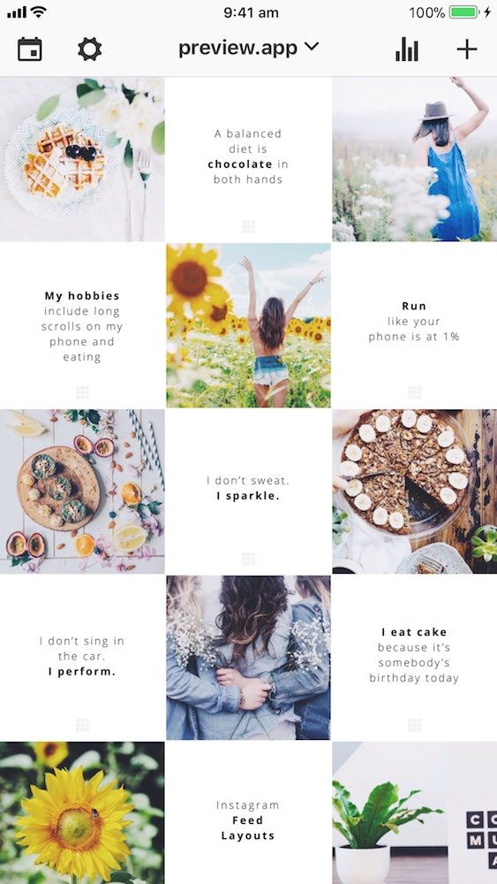

Slide 5
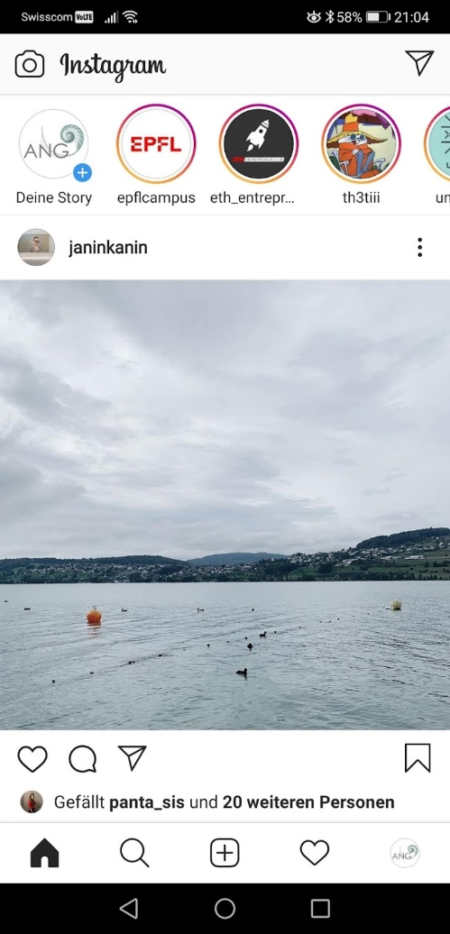
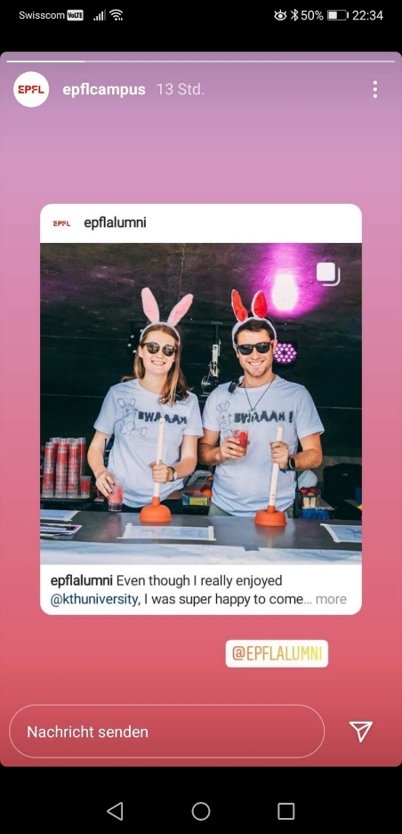
3. Post Instagram Stories
Just swipe right on your instagram feed, add stickers, hashtags, location, tag people
Photos/videos that disappear after 24 hours
Do not appear on your profile gallery or feed
Hidden behind your profile photo
Comment other stories
Show personal insight

Slide 6
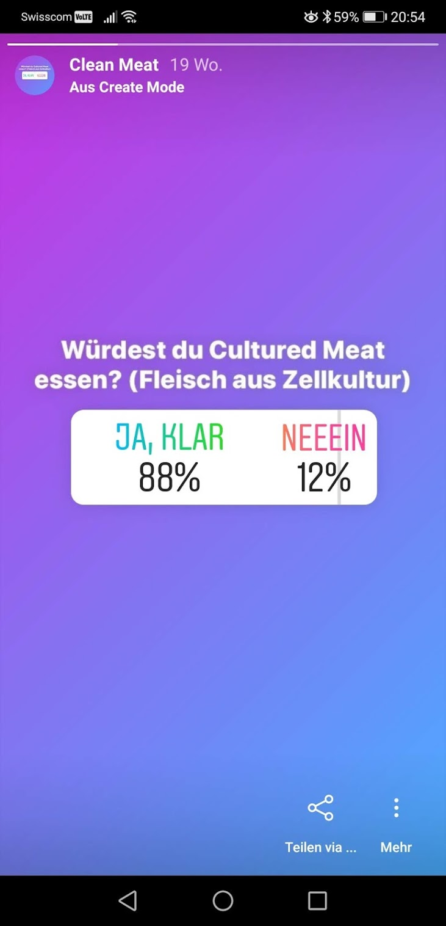
3. Post Instagram Stories
Just swipe right on your instagram feed, add stickers, hashtags, location, tag people
Photos/videos that disappear after 24 hours
Do not appear on your profile gallery or feed
Hidden behind your profile photo
4. Post Instagram Highlights
Bring back stories on your profile
5. Find people to follow
Will appear in your feed
6. Comment on posts
Tap on the speech bubble icon/ heart
When they comment, reply them as soon as possible

Slide 7
7. Convert profile to a business profile
Additional information
Promote your posts
Analytics for your account
Gear icon → swtich to business profile → select facebook page → fill out email adress, phone number, postal adress

Slide 8
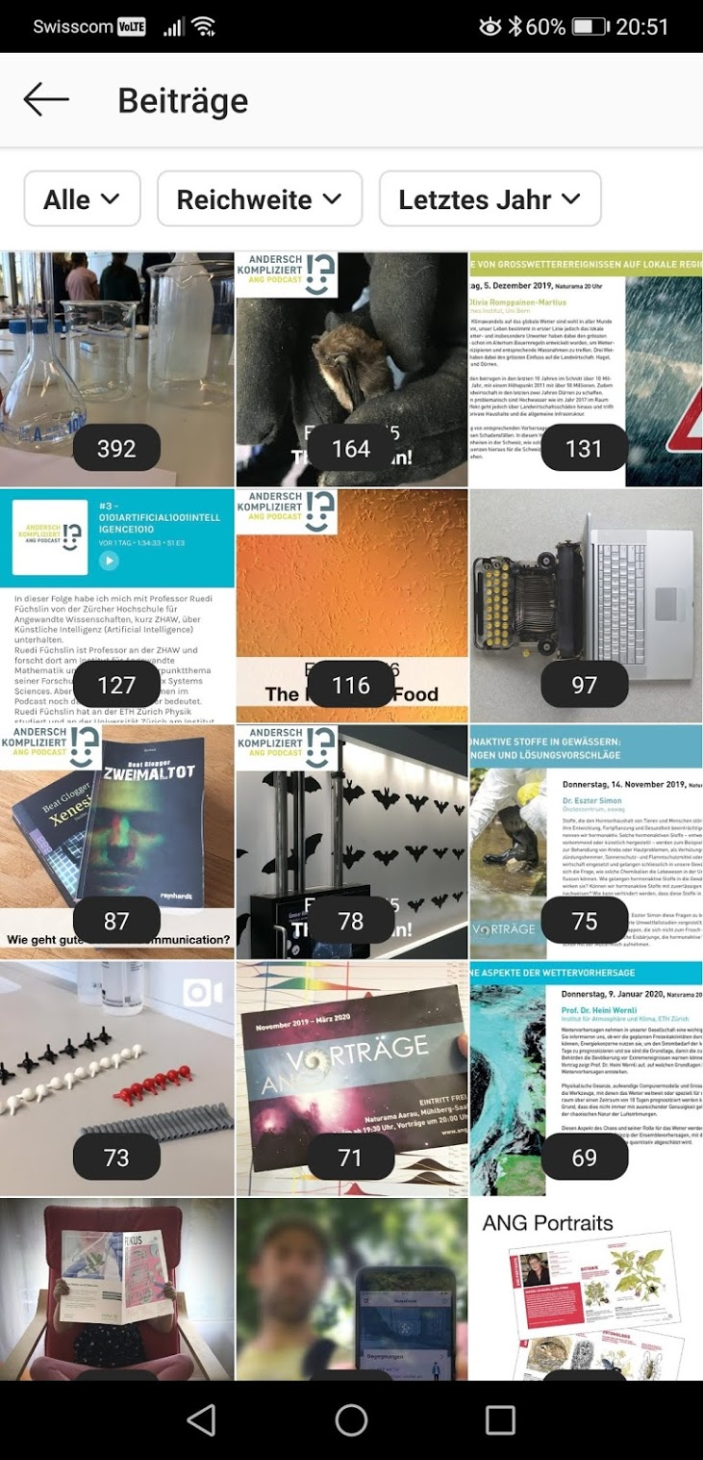
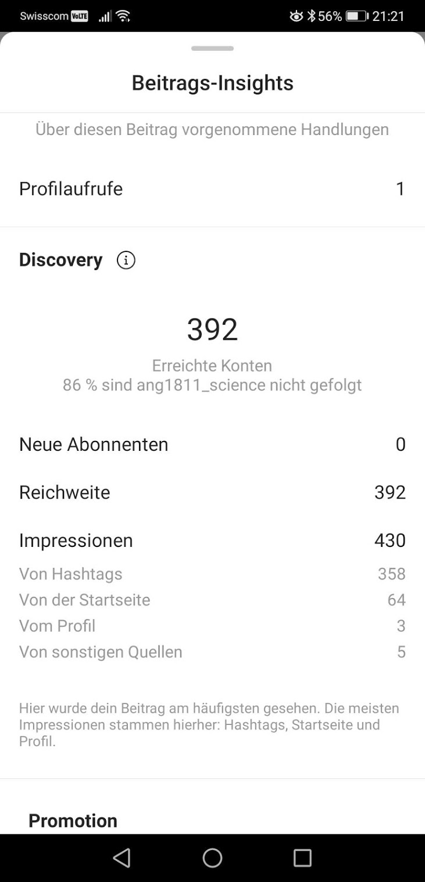

Slide 9
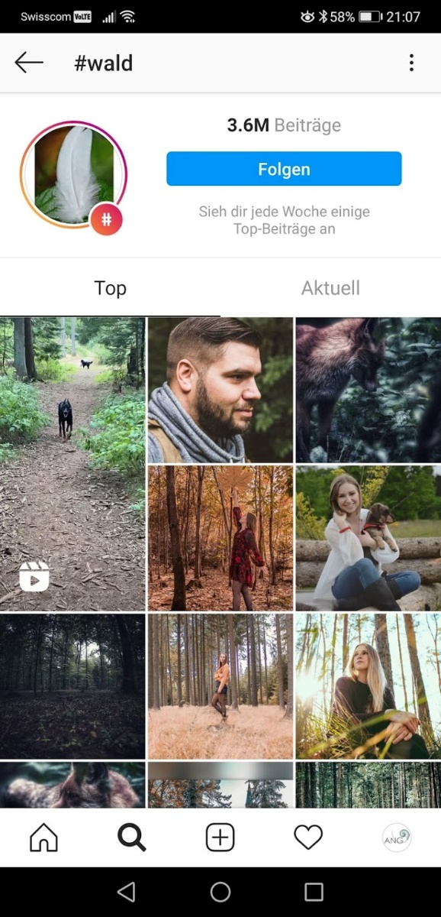
#hashtag
More likes
More comments
More follower
Bestehen aus Buchstaben, Zahlen, Emojis
Für Kategorisierung von Beiträgen
Content zu einem Thema leichter finden
Unternehmensspezifische Hashtags (branded hashtags)
Ortsverlinkungen, Veranstaltungen, Events
Bis 30 Hastags pro Bild, 10 Hashtags pro Story
Bestimmten Hashtags folgen
Hashtags benutzten die zum Content passen

Slide 10
10 wertvolle Tipps
Relationship-Marketingtool: Sympathie und Loyalität aufbauen
Nutzung als dekoriertes Schaufenster
Einblicke hinter die Kulissen schaffen Transparenz und Sympathie
Bildmotive mit emotionalen Faktoren
Planen Sie regelmässige Posts
Lassen Sie die Community teilhaben: Foto-Contest, Hashtag definieren, Gewinn kommunizieren
Verbinden Sie Ihre Inhalte mit Facebook/Twitter
Pflegen Sie aktive Follower-Kultur
Sponsored Posts: bezhalen Sie für prominente Platzierung/Reichweite
Beobachten Sie Ihre Nutzer (Alter, Aktivität)

Slide 11
#ademerci
#fragenkostetnichts

