Slide 1
Reducing CO₂ emissions from air travel at ETH Zurich
SCNAT, 24 May 2019
U. Weidmann, Vice President Human Resources and Infrastructure ETH Zurich

Slide 2
Overview
  Flight reduction as a general topic
  Flight reduction at universtities
  Why do scientists fly?
  Flight reduction project at ETH Zurich
Lessons learned
2

Slide 3
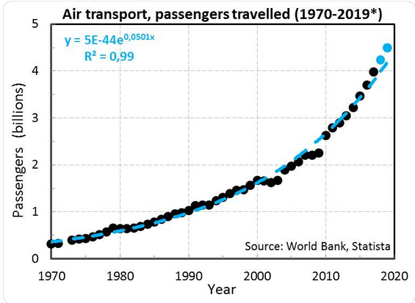
Development of worldwide air travel from 1970 – Jan 2019
from: https://twitter.com/Lacertko/status/1089558645606625282
3

Slide 4
Why is the reduction of air travel relevant (for Switzerland)?
  GHG reduction goal of Switzerland (Paris agreement):
    Minus 20% until 2020 (in comparison to 1990)
    Minus 50% until 2030 (in comparison to 1990)
  Development of air travel from 2010 bis 2015 (Mikrozensus Mobilität und Verkehr, 2015, Swiss Federal Office for Spatial Development):
  Average flight distance per person: 8986 km (2015)
  Increase of the number of flights by 43%
  Increase of the total flight distance per person by 57%
  Affluence: persons living in a household with a monthly income of > 12‘000 CHF travel 5x more by plane than those with a monthly income < 4000 CHF
Flight reduction ETH Zurich

Slide 5
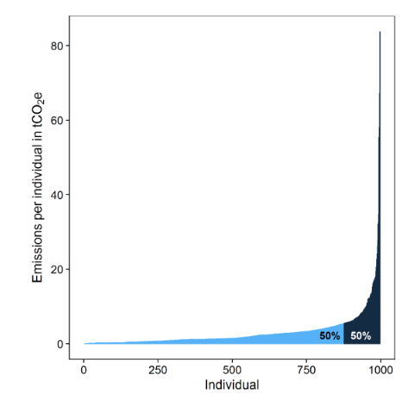
Why is the reduction of flights relevant for universities?
  1. Scientist fly a lot more than the average person (Burian, 2018)
  “On average, Swedish sustainability academics fly 72% more frequently for work alone than average Swedes do in total per year. Related emissions from these flights (2.61 t CO₂-eq) are more than twice as high as those of the flights taken by an average Swede”
  “Academics fly a lot and it has a big climate impact” (K. Nicholas)
2. Few academic fliers are responsible for most emissions
2.
Air travel emissions of 1509 individuals across 8 departments at UBC:
1/3 did not fly
80% emissions by 25% fliers
50% emissions caused by 8% fliers
Wynes and Donner, 2018: Business-related air travel emissions for the 997 individual travellers (one third of the people in the 8 units did not fly during the sampling period). Light blue indicates those travellers responsible for the first 50% of emissions and dark blue indicates those responsible for the second 50%
5

Slide 6
Why is the reduction of flights relevant for universities?
  3. Leading by example
  «Academic leaders reducing flying increase public willingness to reduce their own emissions»*
  Leaders who give up flying because of climate change seem to influence the attitudes and behaviour of others. „Leading by example by giving up flying appears to send a powerful and effective message“**
  Trendsetting
  4. Credibility
  The public finds scientist who fly less more credible ***
* https://www.slideshare.net/kimberlynicholas/academic-flying
** S. Westlake, 2017, https://papers.ssrn.com/sol3/papers.cfm?abstract_id=3283157
*** Attari et al. (2016, Climate Change)
6

Slide 7
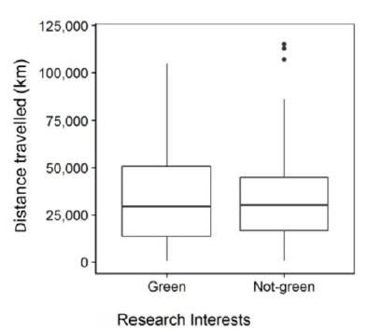
Why is the reduction of flights relevant for universities?
  5. Academic air travel has limited influence on professional success****
  … but up to now, there is no difference
  between “Green faculty” and “Not-green faculty”
  for total avoidable emissions or
  total avoidable trips
**** Wynes et al (2019, J of Cleaner Production)
Wynes et al, 2019: Air travel behaviour of 128 reseach faculty in the core sample divided into «Green» or «Not-green» area of interest.
7

Slide 8
Why is the reduction of air travel difficult?
  General:
    Surveys regularly reveal that environmental issues are considered important, but this does not automatically translate into respective action*
    From knowledge → to awareness → to action
  Universities:
    Internationalisation and hence (overseas) travel have sometimes become a value of its own → reconsider incentives/evaluation criteria
    Conflict of interest between scientific excellence and flight emissions → evaluate necessity of travel and number of people travelling; do multi-purpose travel
    Costs: flights are massively subsidised and prizes don’t reflect real costs
    Time: save time by not travelling (and using VC); high-quality travel time on train
  Conclusion:
    Science requires innovation and creativity
    «Business as usual» is no option
* Kuckartz 2008; http://www.bpb.de/izpb/8971/umweltbewusstsein-und-umweltverhalten?p=all
8

Slide 9
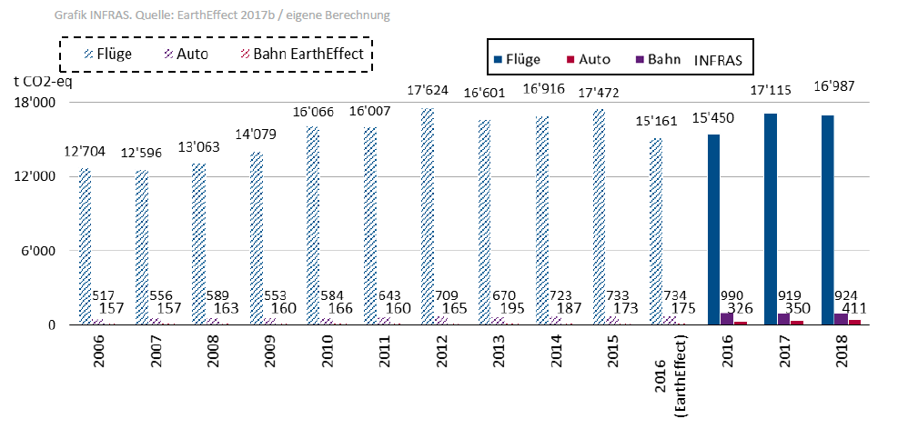
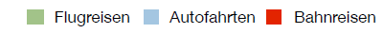
Why is air travel the #1 leverage to reduce CO₂ emissions at ETH?
t CO₂eq
Flights
Cars
Trains
  More than half of CO₂ emissions at ETH are from business travel, 93% from flights, mainly overseas
  Total emissions increased since 2006; emissions per FTE nearly constant
  Emissions from student flights have doubled from 2006 – 2015
  New monitoring system based on flight number, class and date
9

Slide 10
Activities at ETH Zurich
2016/2017: Student initiative to reduce air travel emissions
2016: Vice President Human Resources and Infrastructure inititates the mobility platform with one thematic focus on flight reduction (www.ethz.ch/air travel)
2016: Mobility platform comissions a concept on how to reduce air travel at ETH
2017: Governing Board decision: top down decision by the governing board
2017/2018: Bottom up implementation by the departments to define a reduction goal with the respective measures
2018: ETH-wide reduction goal of average 11%
2019 - 2025: Implementation and monitoring
2022 und 2025: Evaluation
10

Slide 11
Air travel reduction at ETH Zurich – Status quo:
Measures of the departments
  Internal Carbon Pricing: money can be used for compensation, internal research projects and teaching
  Compensation: only preliminary measure, not part of the reduction goal
  Recommendation: 1 intercontinental conference/PhD, train until 600–800 km with 1. class tickets, more VC (job interviews, PhD defenses, project meetings etc.), combine different activities (conference, meetings, field work)
  Transparency about flights within departments
  Support conferences in Europe, bi-annual conferences (instead yearly)
  Support VC ETH-wide, adapt ETH regulations (less incentives for flights)
PhD project to study the transformation process related to ETH Zurich‘s flight reduction project (Agnes Kreil)

Slide 12
Lessons Learned
Top down support is essential
Bottom up travel decisons by individuals → involve all staff and students (not just interested individuals)
Transparency
Good database for monitoring
Change framing: from reduction to alternatives for flights
Important role of champions and influencers, Trendsetting
Discussion about conflicting targets (personal contacts/international research cooperations/field work AND climate goals)
Wicked problem → there are no simple solutions but different and creative approaches (trial and error)
Cultural change needs endurance
Common approach of many universities needed to be successful

Slide 13


