Slide 1
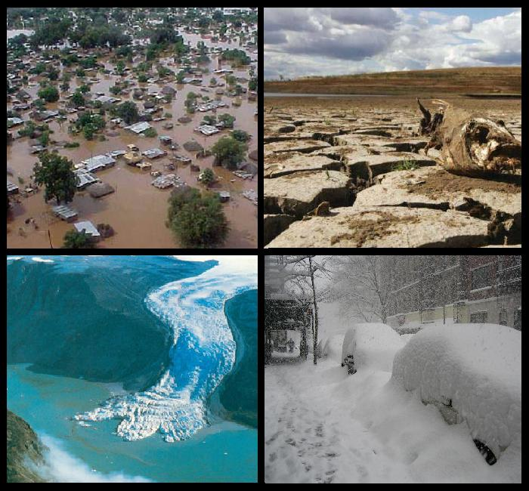

Does Rapid Arctic Warming Affect
Extreme Weather in Europe?
Jennifer Francis
Institute of Marine and Coastal Sciences
Rutgers University

Slide 2
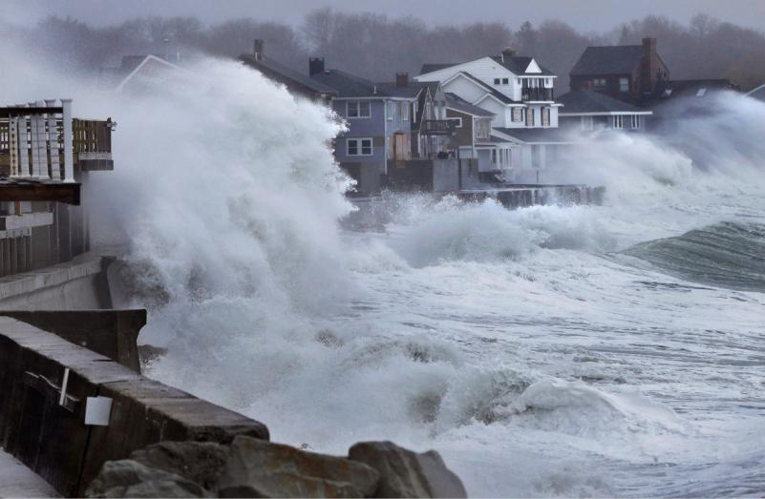
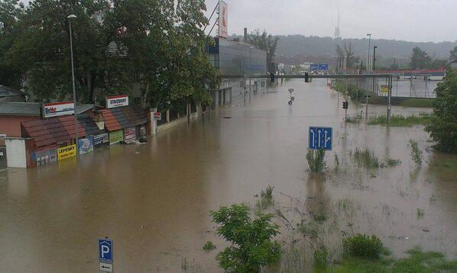
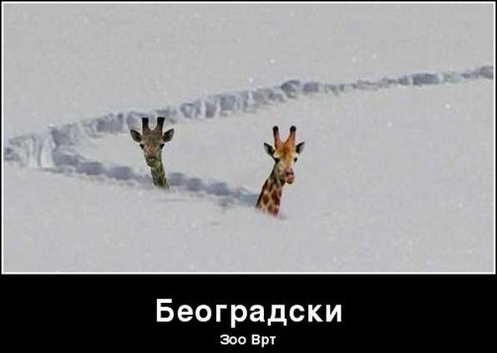
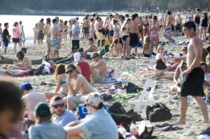
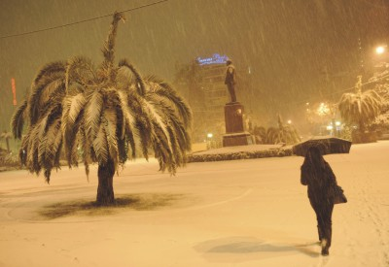
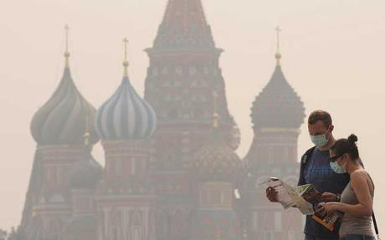
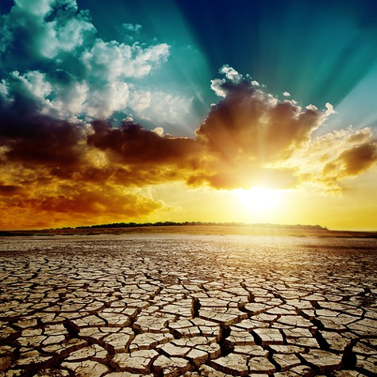
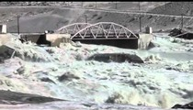
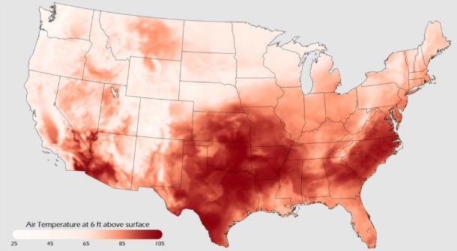
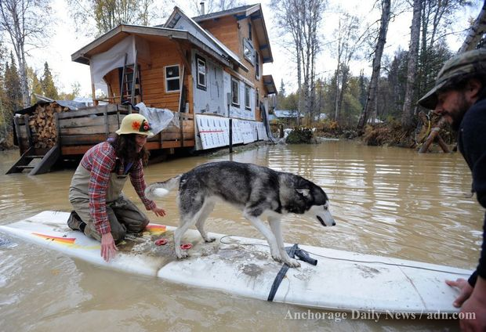
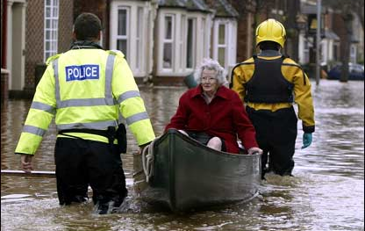
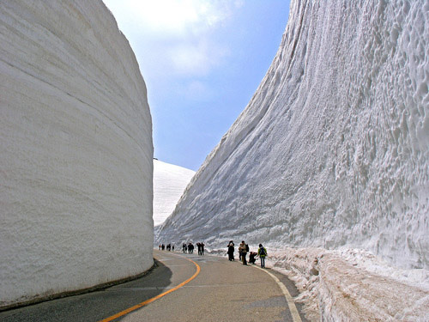
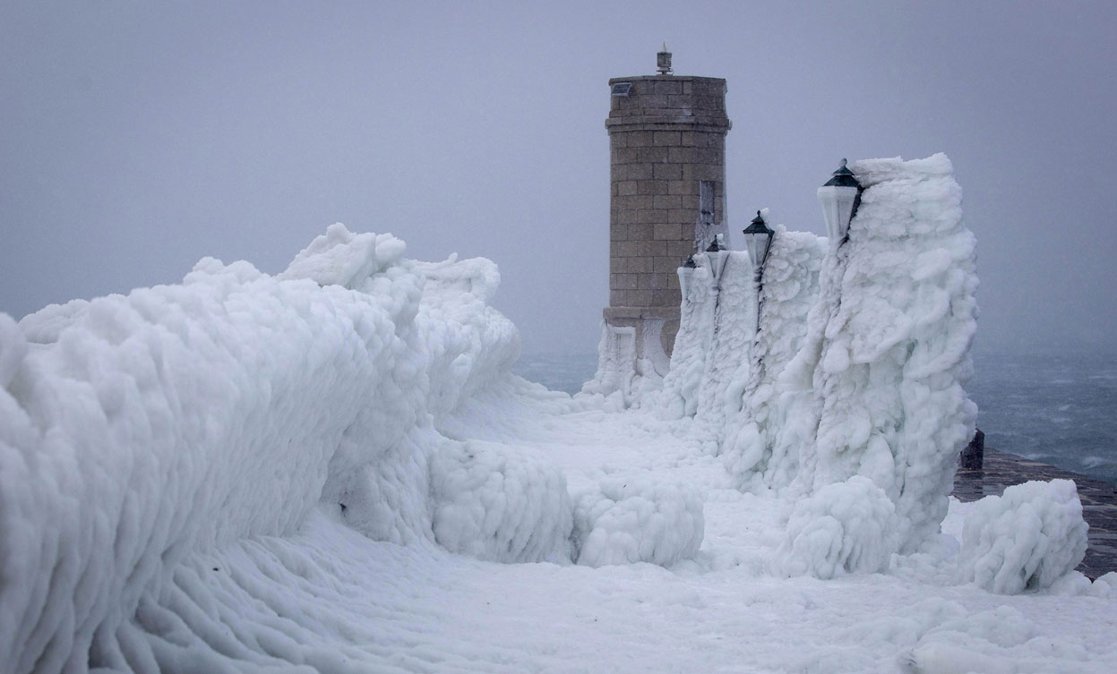
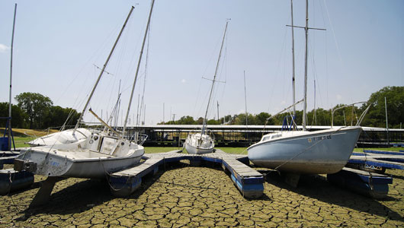
A Smörgåsbord of Wacky Weather…
Central Europe – spring 2013
Scituate, MA -- 2013
March 2012 in Burlington, VT
Black Sea
UK – Winter 2014
Greenland – summer 2012
Europe
Summer 2012
CA drought 2013-2014
Alaska Sept. 2012
What do these events have in common?
“Stuck” weather patterns
Texas
Japan 2012

Slide 3
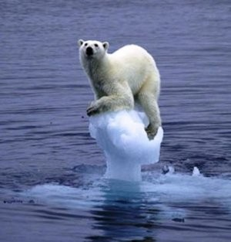
Is human-caused climate change
playing a role?
So, what the heck is going on??
YES !

Slide 4
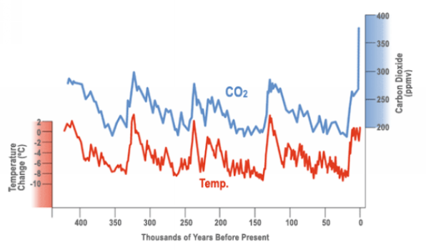
We’ve put ourselves in a real pickle…
CO₂ now highest in at least the past 800,000 years
NAS, Oct. 2012
Present
CO₂ levels are WAY out of whack with temperature
The last time CO₂ levels were this high, the globe was several degrees warmer, sea levels were tens of feet higher.

Slide 5
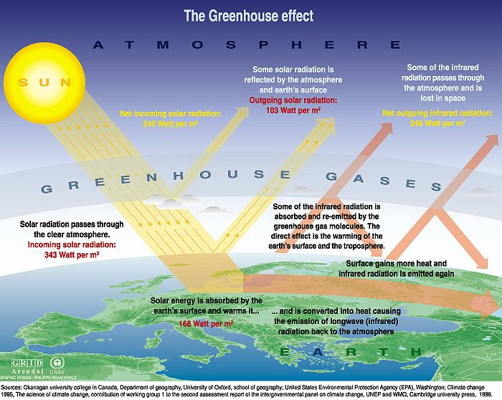
What are Greenhouse Gases and why are they such a Big Deal?
10,000ºF
60ºF

Slide 6
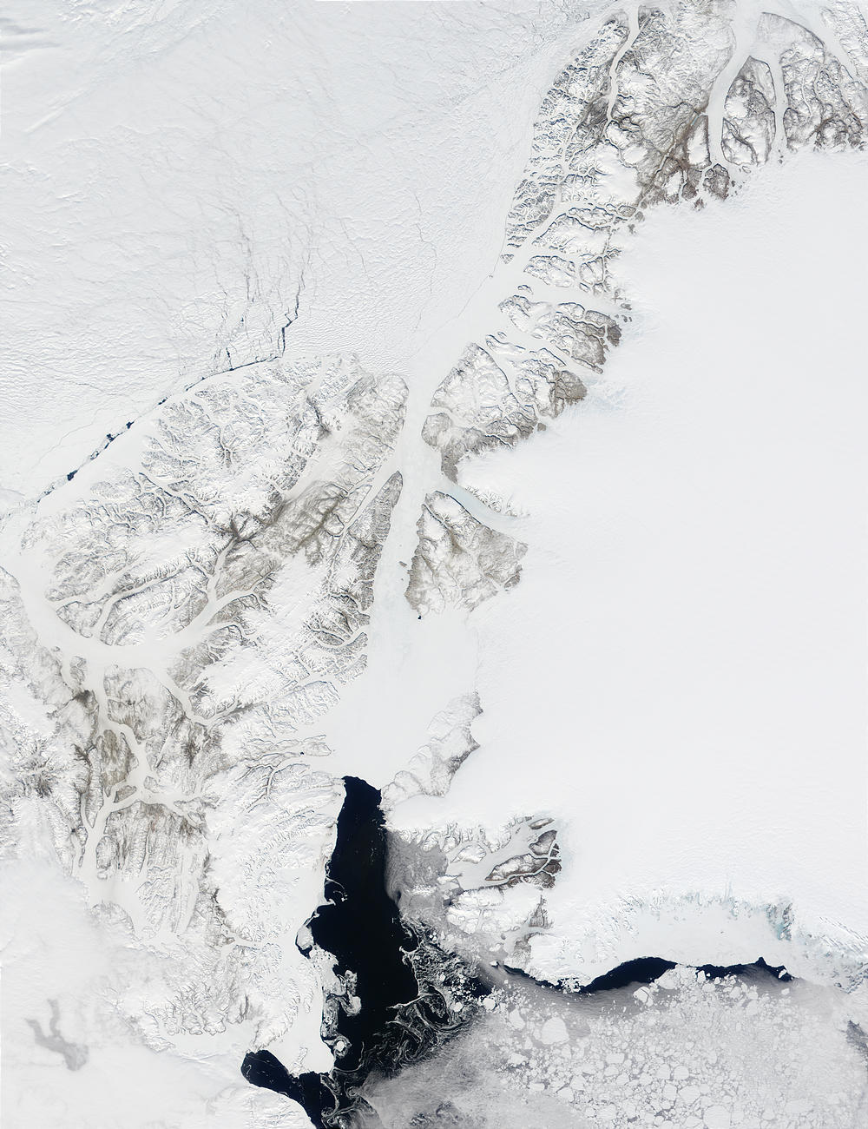
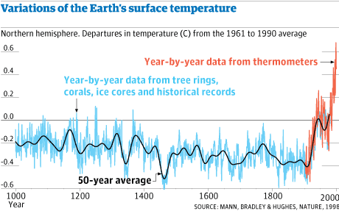
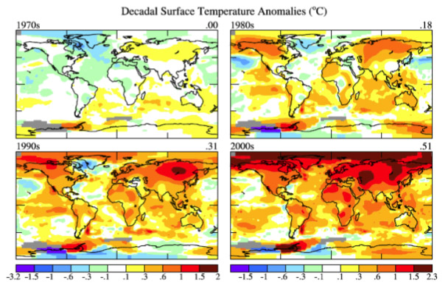
The Earth’s temperature is starting to catch up…
12 of the 14 warmest years on record occurred since 1998
Annual temperature anomalies
2000 -- 2010
…although not evenly around the globe.
Feb. 2014 was 348th consecutive month above average
From NASA/GISS

Slide 7
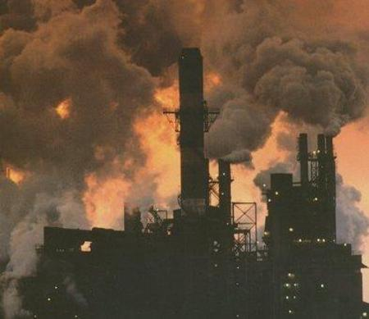
How do we know that humans are responsible?

Slide 8
Evidence implicating humans
Solar + volcanic
(natural)
Observed
One of our best tools: computer programs
- climate models - that simulate the complex physics of the atmosphere, ocean, snow, ice, and land and all the forces acting on them.
Modeled
All forcings
(natural + human)
Notes:
Climate models are important tools for attributing and understanding climate change. Understanding observed changes is based on our best understanding of climate physics, as contained in simple to complex climate models. For the 4rth assessment report, we had a new and very comprehensive archive of 20th century simulations available. This has greatly helped.
This figure gives an example.
You see observed global and annual mean temperature in black over the 20th century compared to that simulated by a wide range of these models. On the top, in red, are individual model simulations and their overall mean shown fat, that are driven by external influences including increases in greenhouse gases, in aerosols, in changes in solar radiation and by volcanic eruptions. The observations rarely leave the range of model simulations. The trends and individual events like cooling in response to volcanic eruptions (POINT) are well reproduced. The fuzzy range gives an idea of uncertainty with variability in the climate system.

Slide 9
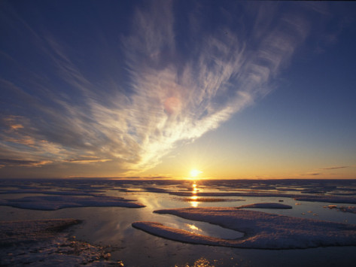
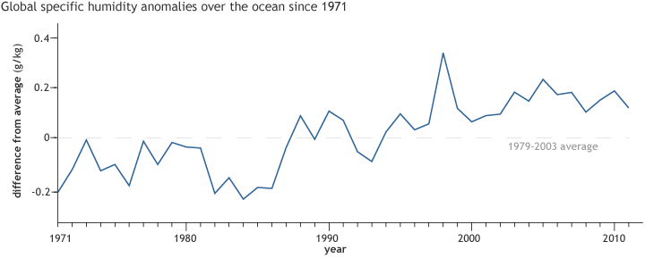
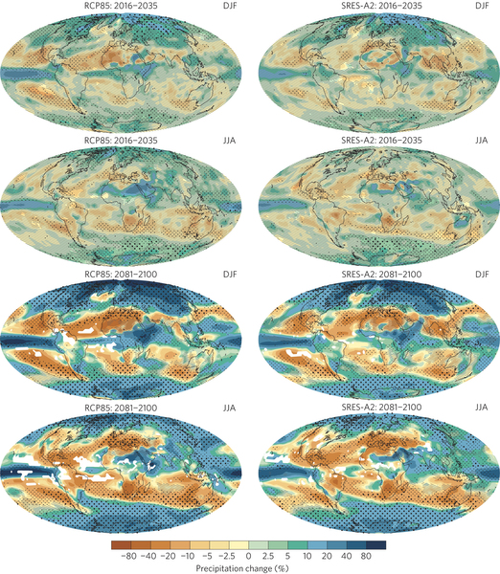
And the atmosphere is gaining moisture…
…providing more fuel to energize storms and more water to promote heavier precipitation…
…making wet places wetter, while a warmer world increases evaporation, making dry places drier…
Global specific humidity
from ClimateWatch.noaa.gov
from Knutti and Sedláček, 2012
Mother Nature’s deck of cards has changed…

Slide 10
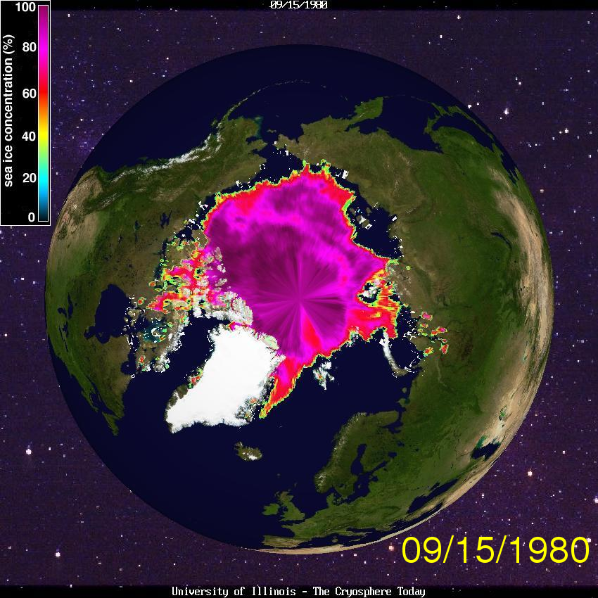
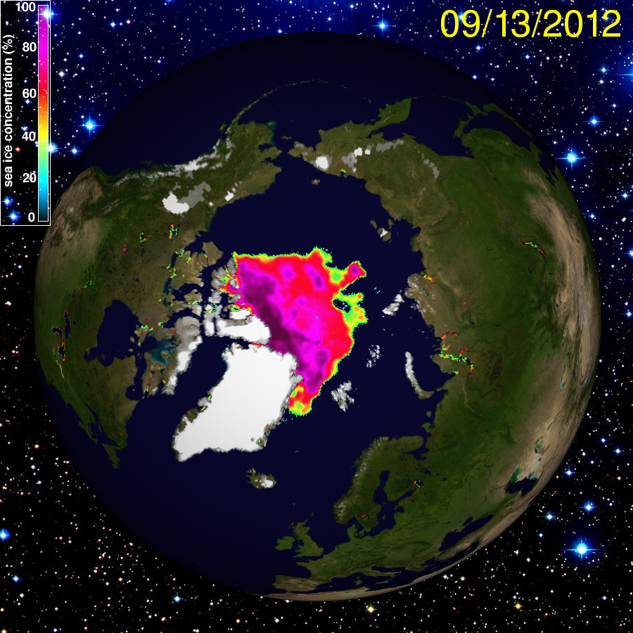
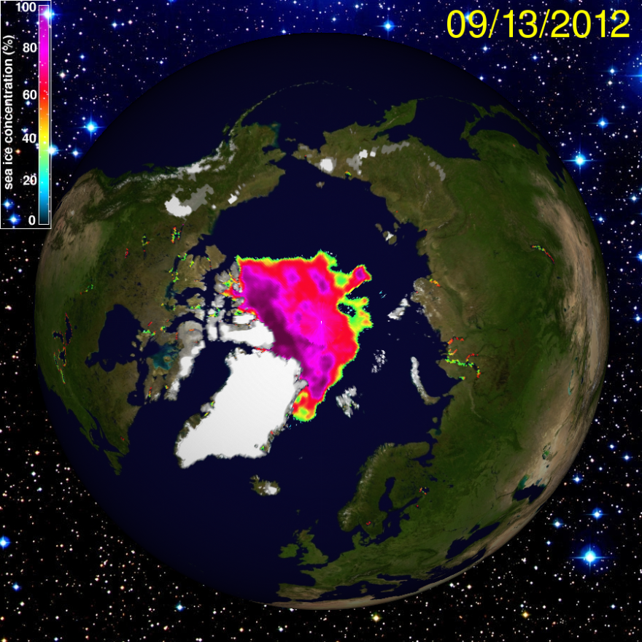
Sea ice is now a mere shadow of former self…
About HALF of summer ice cover has been lost…
…and 75% of the ice volume…
What’s left is “rotten” and “slushy”
… in only 30 years

Slide 11
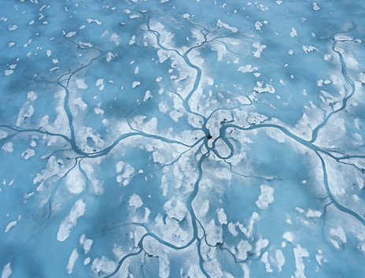
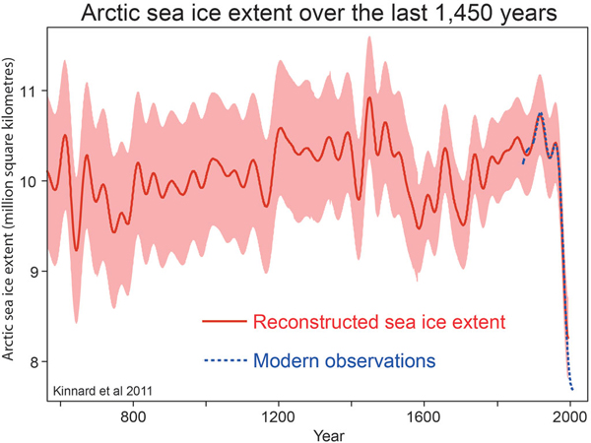
How unusual is the recent loss of Arctic sea ice?
2012

Slide 12
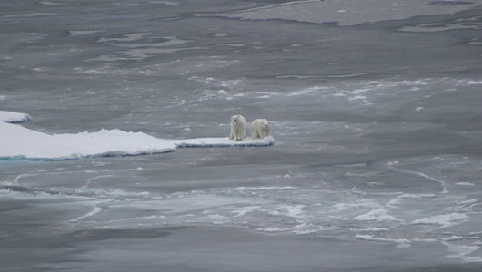
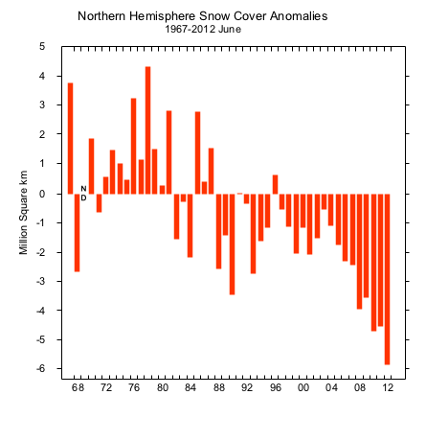
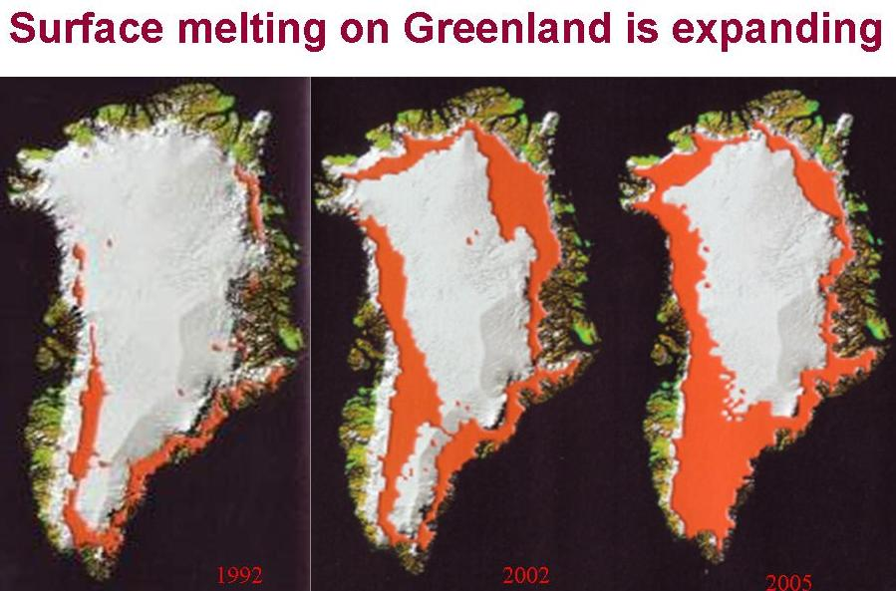
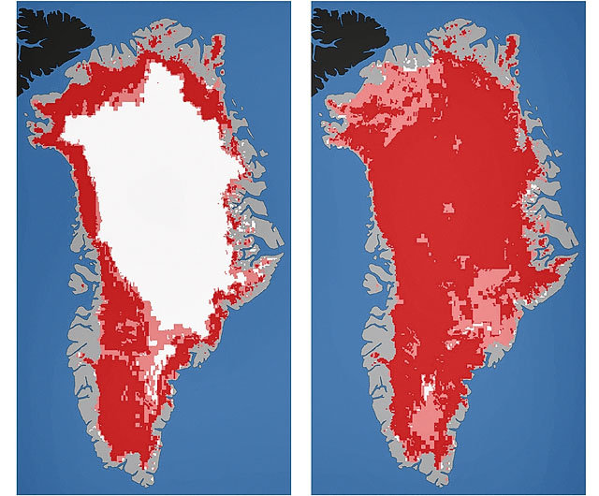
2012 was a really tough year for the Arctic…
N. Hemisphere Snow Cover Anomalies
June 1967-2012
Nearly the entire surface of Greenland melted for the first time in at least 150 years
Spring snow cover on high-latitude land smashed previous minimum records
from Rutgers Snow Lab
1992 2002 2005
2012

Slide 13
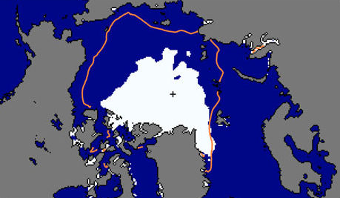
Mean ice extent
1979-2000
The Arctic is warming 2-3 times faster than the rest of the globe
Ice extent September 2012

Slide 14
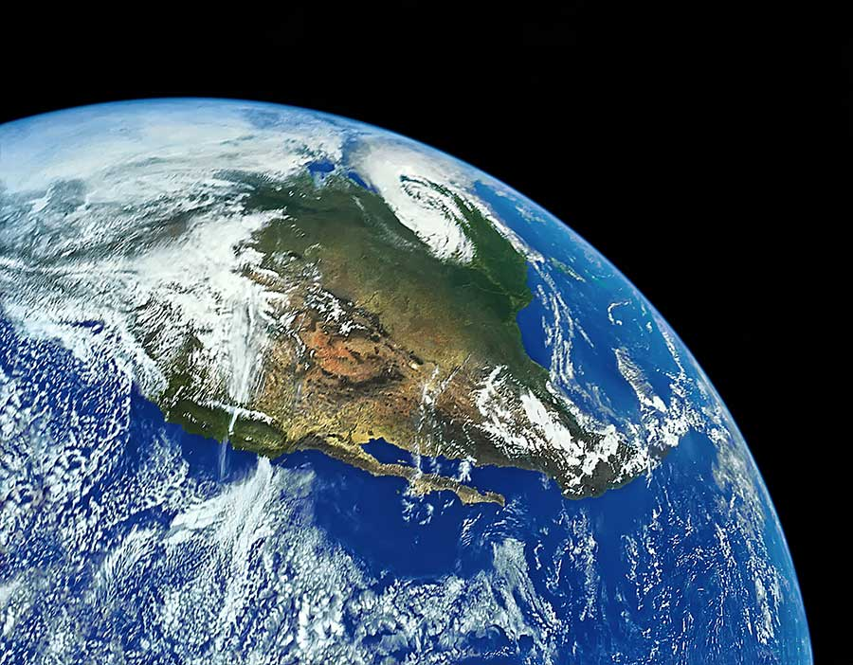
Consider a layer of atmosphere stretching from here (warm) to the Arctic (cold)
Because warm air expands, the layer will be thicker here than it is in the Arctic.
Air flows down this “hill”, turns to the right as the Earth spins, and creates the Jet Stream
COLD
As the Arctic warms faster, the hill flattens, and the jet stream weakens
WARM

Slide 15
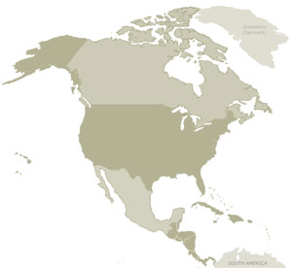
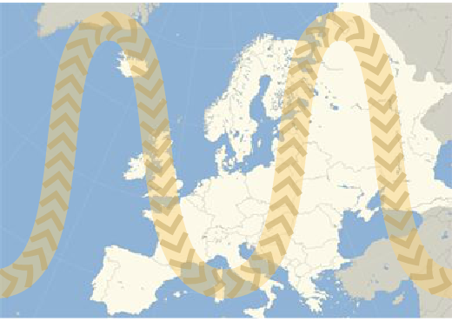
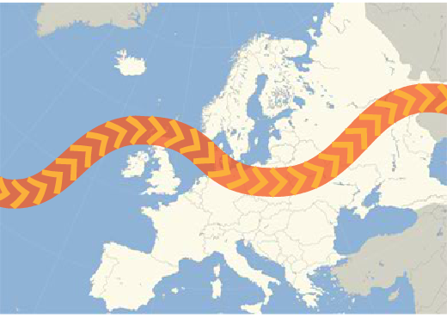
When the waves are small, they move eastward quickly.
When the waves are large, they shift slowly…and so does the weather they create
Graphics by John Garrett for SkepticalScience.org

Slide 16
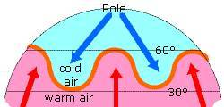
Why do we care about these waves?
The Jet Stream makes our weather
OND
Wet and
stormy
Dry and
settled
NASA Jet Stream

Slide 17
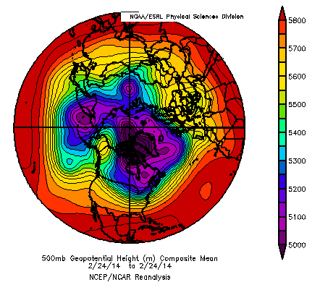
A “topographic map” of a layer
in the atmosphere

Slide 18
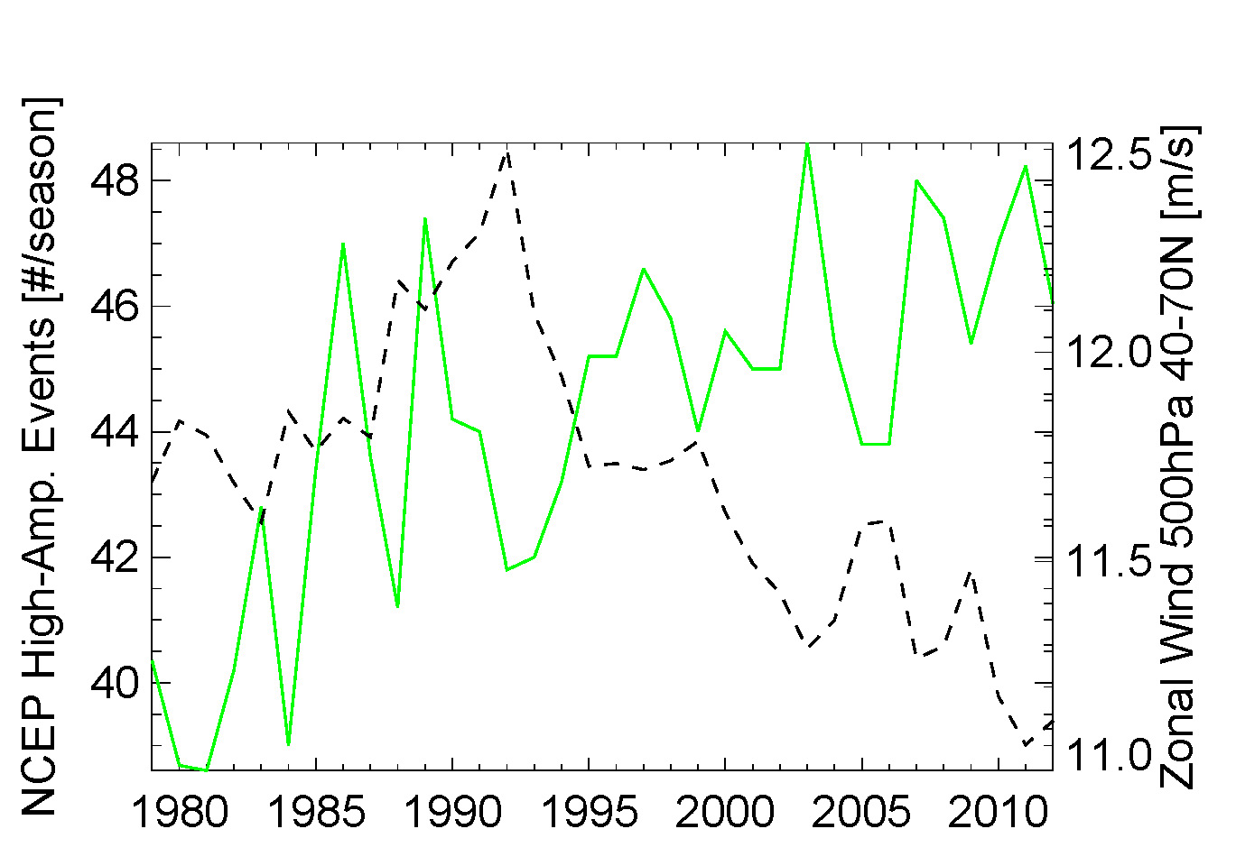
Are the jet-stream waves really getting bigger?
Fall (Oct-Dec) Northern Hemisphere
High-amplitude waves
Upper-level westerly winds

Slide 19
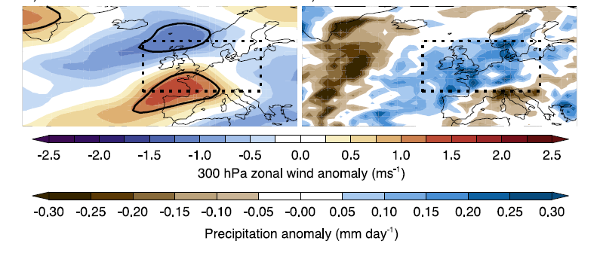
Wet UK summers connected with years with low Arctic sea ice…
Screen, 2013

Slide 20
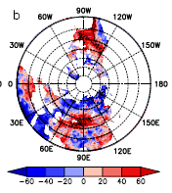
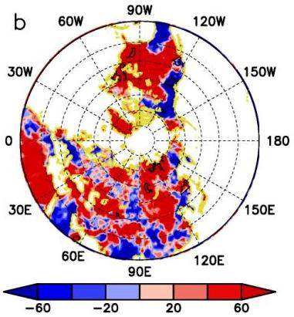
Winter cold extremes
  Fall and winter sea-ice loss associated with cold extremes, but influence of winter ice is stronger
Summer heat waves
  Summer loss of sea-ice and snow cover associated with heat waves, but sea-ice influence is stronger
Tang, Zhang, and Francis, Nature Cl. Ch. (2013)
Tang, Zhang, Yang, and Francis, ERL (2013)

Slide 21
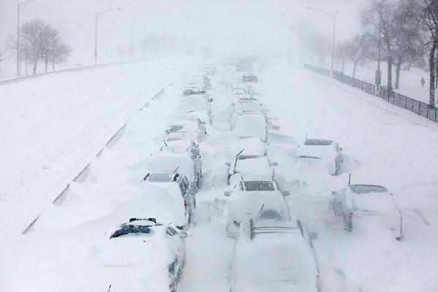
Do recent extreme weather events patterns fit this story?

Slide 22
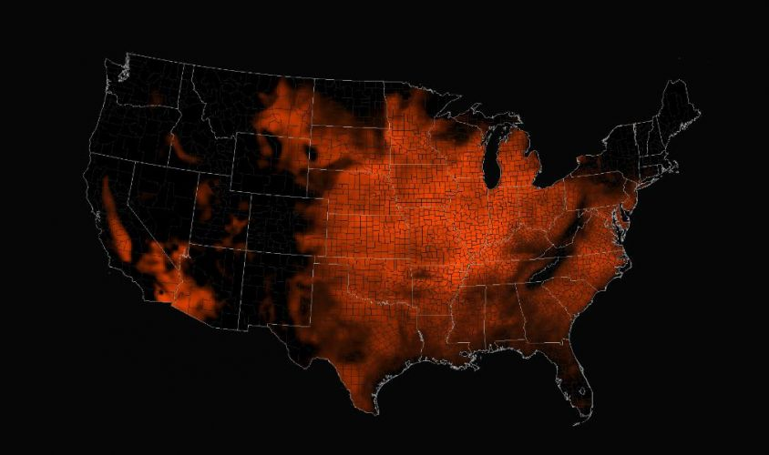
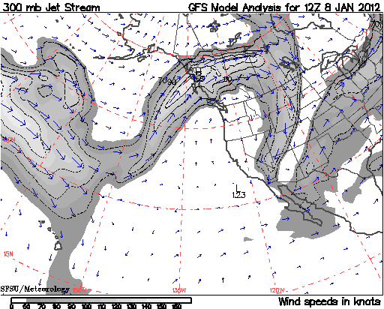
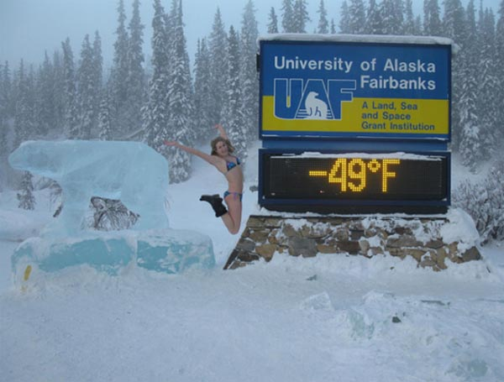
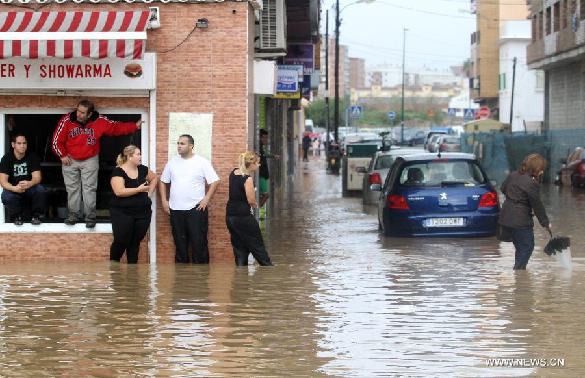

The jet-stream signature of persistent patterns that can lead to extremes…
AK
CA
Record snows in AK
from San Fran. State U.
MA
Spain
Unprecedented flooding in Spain

Slide 23

The Remarkably Persistent Pattern: Dec.‘13-Feb.‘14
Warm
Cold
Warm

Slide 24

THANK-YOU !!
francis@imcs.rutgers.edu

Slide 25


The $64B question: Was the path of Sandy affected by the record sea-ice loss in 2012?
The Arctic was MUCH warmer than normal
Was block strengthened, extended northward, or prolonged by AA?
It looks that way.
As oceans warm, hurricane seasons may lengthen, storms can survive farther north, and perhaps interact more frequently with jet-stream troughs

